Slide 1

London Frolics
Dom, Lydia, Allegra and Cynthujaa

Slide 2
Designing the database
Drafted user stories based on:
Blogger
Administrator
Subscriber
Reader
MOSCOW to prioritise the functionalities
Designed database – relatively simple (with post / user tables, and normalisation tables)

Slide 3
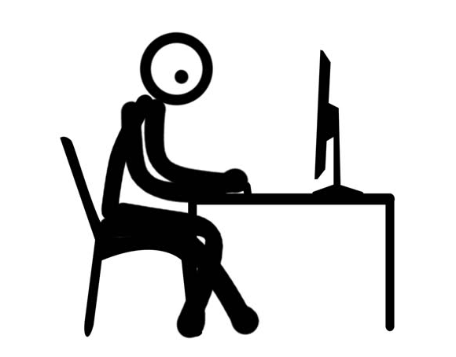
As a Blogger, I want to add posts so I can share my experiences with others.

Slide 4
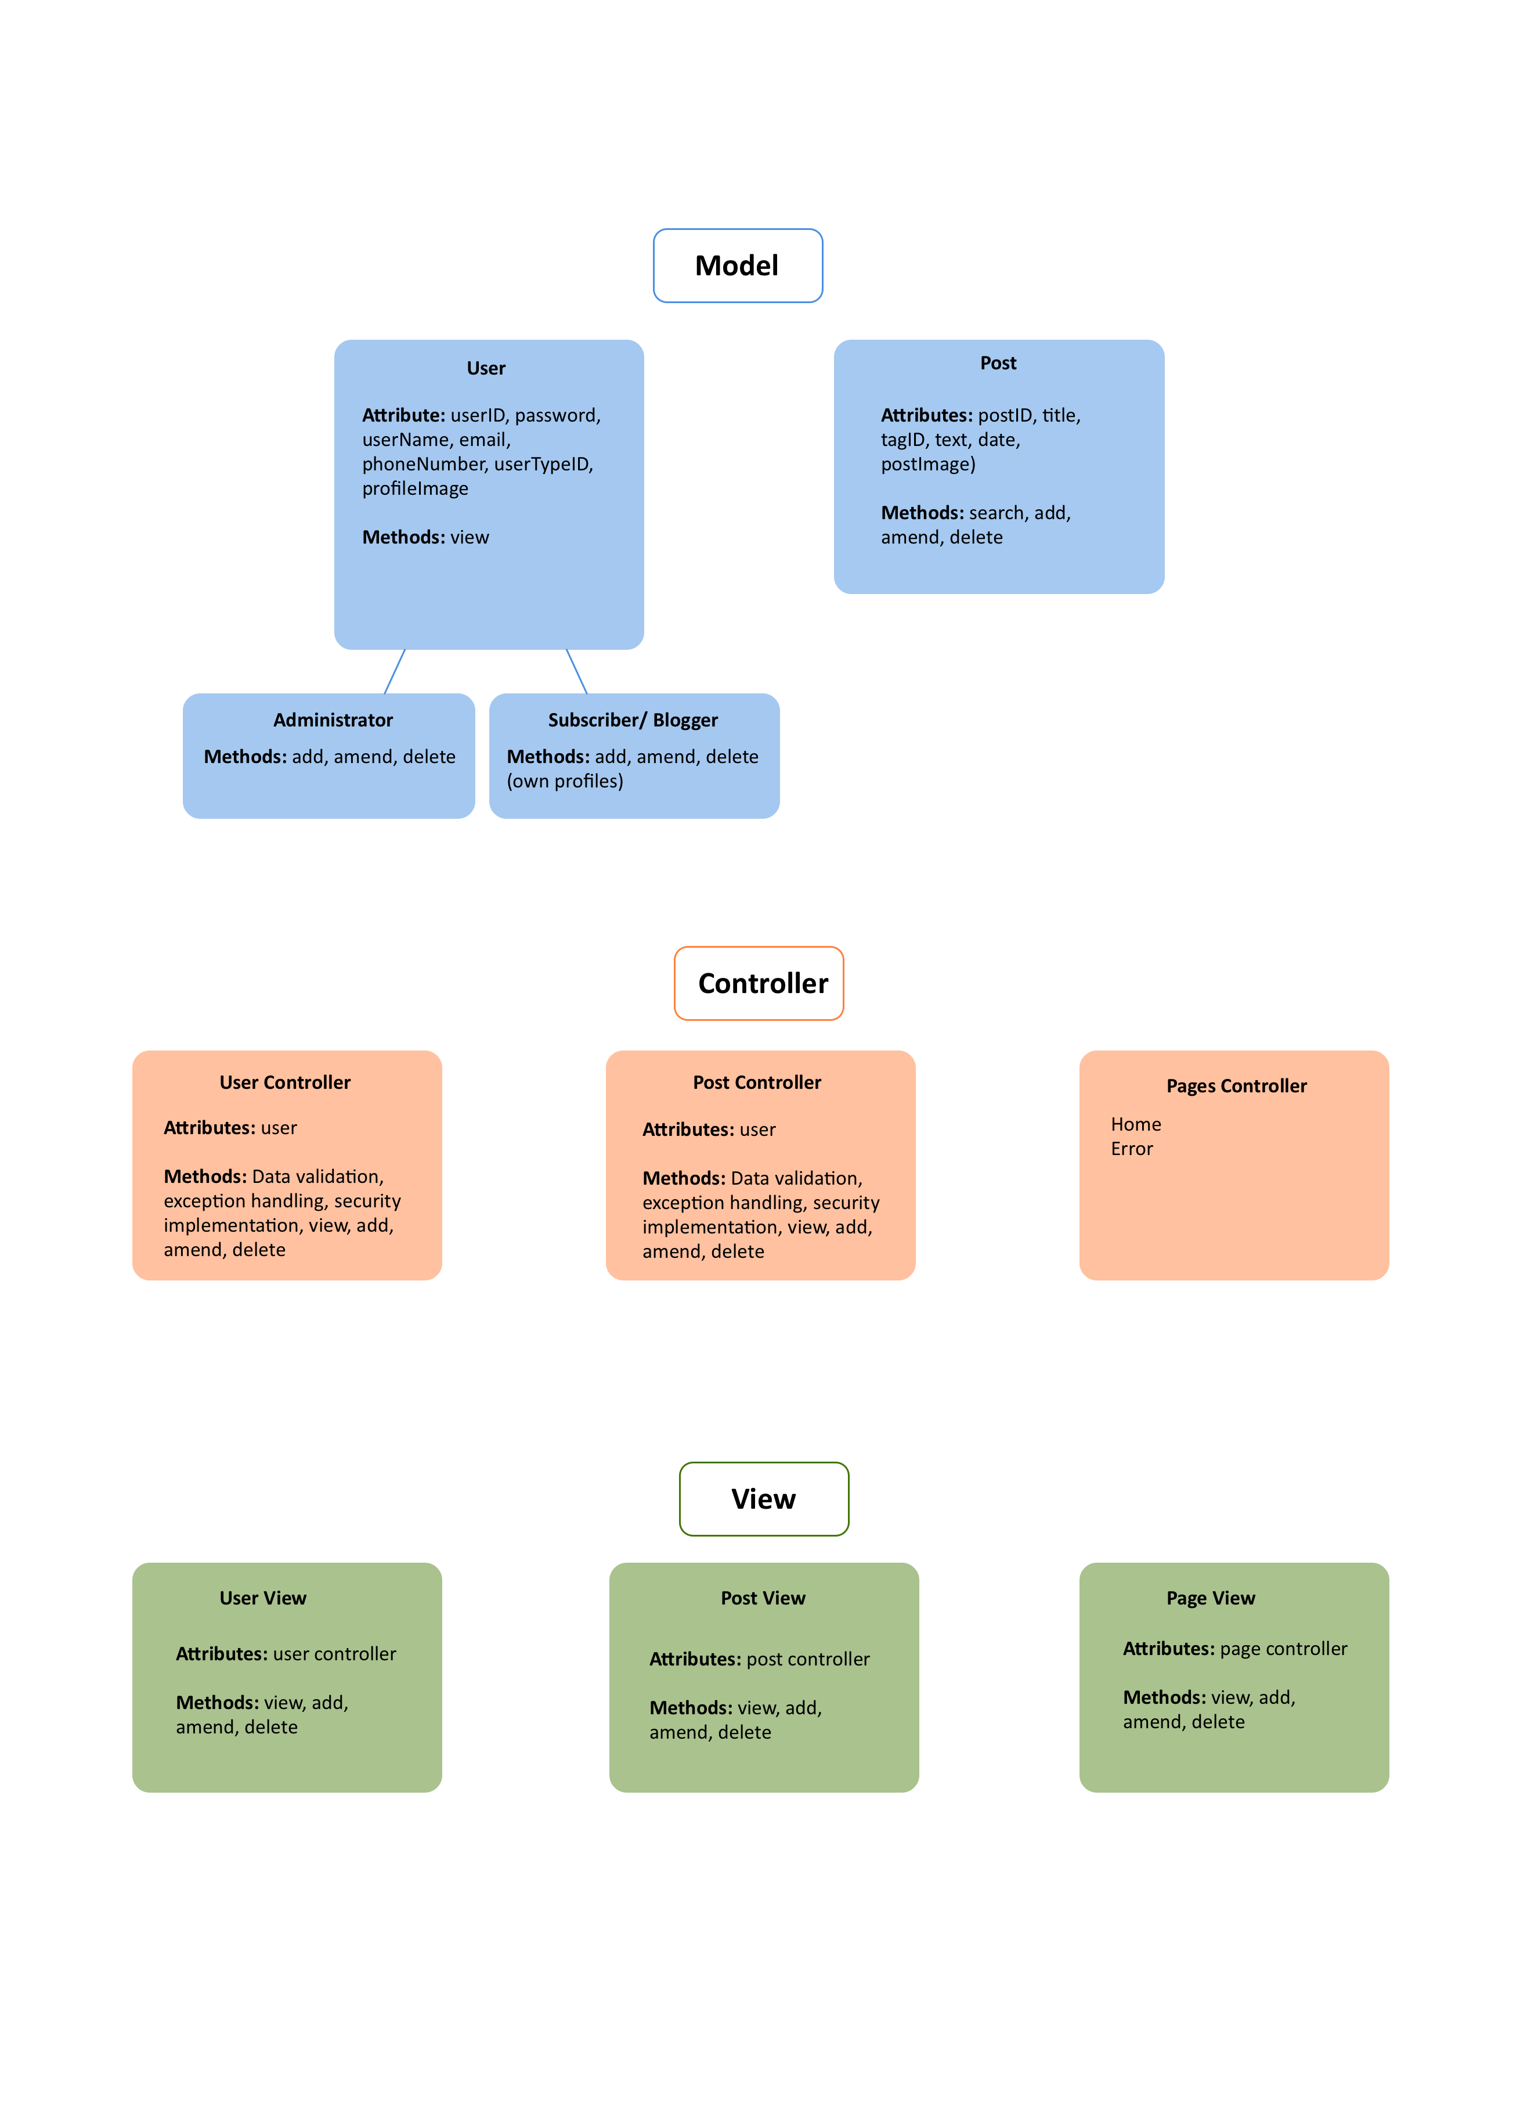
MVC model

Slide 5
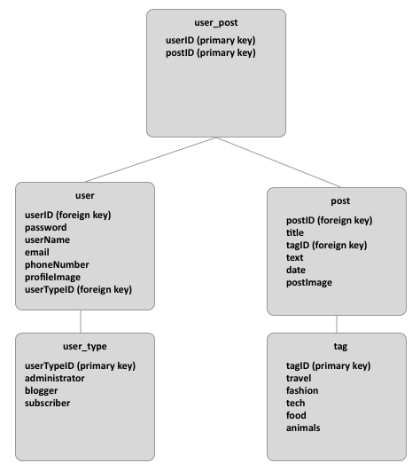
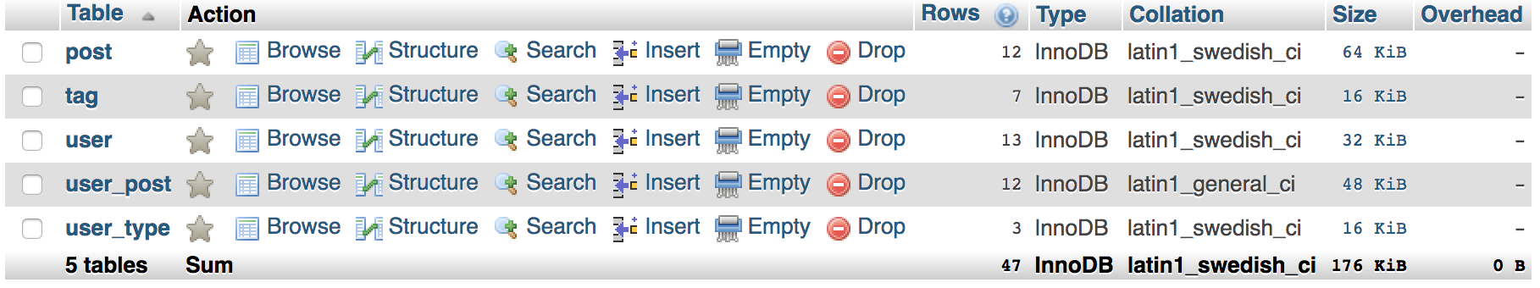
Database Design

Slide 6
Wireframe

Slide 7
The Website
Amended the code to reflect the functionalities needed and added the following:
Registration form – add new users, password confirmation
Dynamic navigation bar
Log in / Log out (sessions)
Sharing posts (Reddit, Twitter, Facebook)
My Posts (update, delete, create, viewAll, read)
My Profile
Search function (%like%)

Slide 8
No Frolicking
Organisation
Weekend / weekday Hangouts
Daily standups
Final Hangout
Agile / Scrum – designated scrum master
Tools we used
Trello
Whatsapp
GitHub

